Slide 1
Command Line Compiling

Slide 2
Command Line?
Command-Line Interface (CLI)
Text-based method of communicating with your OS
Or some other program
For programs (or users) that don’t require a graphic interface (GUI)
Execute core operations of the OS (creating, deleting, moving files, etc)
Execute non-OS programs (the things you write)
We’ll look at this last one to compile our programs

Slide 3
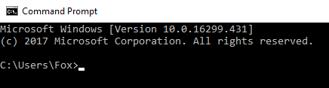
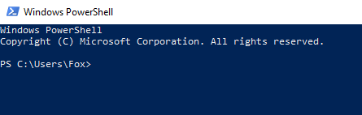
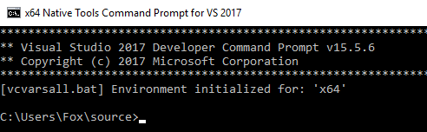
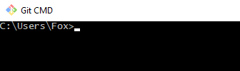
Command Line Environments
List may vary based on OS and/or compiler
Command Prompt
PowerShell
Git CMD (if you have Git Installed)
Terminal, Bash, etc…
They all serve the same purpose: Let you communicate with the operating system

Slide 4
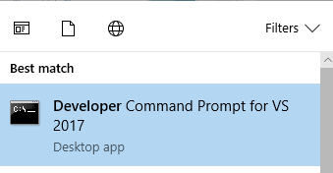
Command Line Basics
In Windows, Start->Run “cmd” to bring up the terminal window
OR, if you have Visual Studio, you would want to use the “Developer Command Prompt for Visual Studio <version number>”
Why? It sets up various environment variables to find the location of the compiler and other commands
And then resets those variables when the terminal window is closed
OR, whatever you might prefer to use
In other operating systems? Google is your friend. ☺

Slide 5
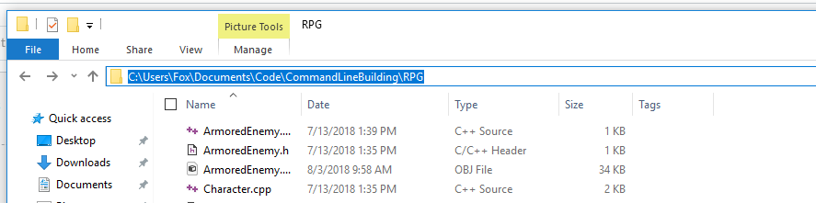

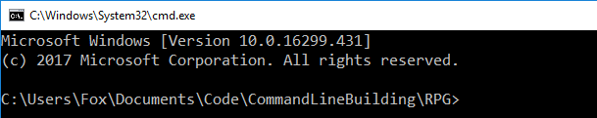
Or…
1. Click the address bar
Type cmd + <enter>
Opens a command prompt set to that directory
Faster than typing:
cd C:/Users/Fox/Documents/Code/etc…

Slide 6
Basic Command Line… commands…
cd Change directory. Everyone should know this.
> cd c:/
> cd c:/Users/Fox/Documents
> cd c:/Users/Fox
> cd Documents
> cd..
Change to a specific directory anywhere on a drive
Change to a local directory within the current one (users\Fox in this case)
Move up one directory
From "users/Fox/Documents", back to just "users/Fox"

Slide 7
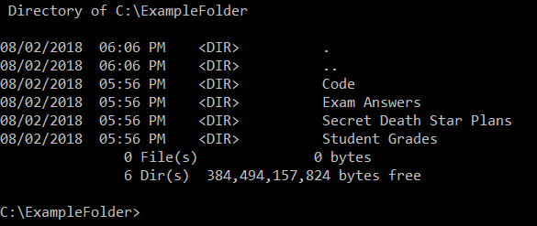
Basic CLI commands – show directory
dir Show the contents of the current directory (on Windows)
ls Same thing, but for Unix-based systems
> cd c:/ExampleFolder
> dir

Slide 8
Lots and lots of commands
mkdir – Create a directory
rmdir - Remove a directory
copy x, y - Copy file x to directory y
del - delete a file
exit - exit the command prompt
cls / clear - clear the CLI window
And so on… every OS has a list of commands, many unique to that OS
Everyone should know cd and dir/ls – basic navigation

Slide 9
Case sensitivity
Windows is NOT case sensitive for things like filenames, paths, and CLI commands
dir == DIR == DiR == diR, etc…
DATAFILE.txt == datafile.txt == DaTaFILE.txt, etc
Unix-based environments ARE case-sensitive:
ls != LS != Ls
myprogram != MyProgram
folder/subfolder != folder/SubFolder

Slide 10
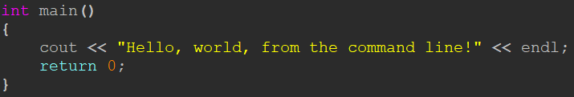
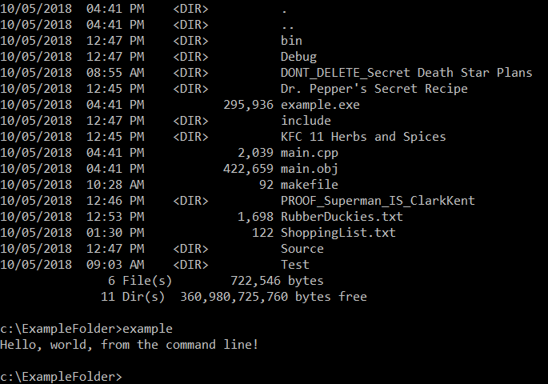
Running Programs from CLI
This code…
<nameOfProgram> - Execute a program
Some operating systems may have different requirements
Turns into this executable…
Windows:
example (or example.exe)
Unix: ./example.exe
./ means start in the current directory
Which we can execute here

Slide 11
Compiling from the command line
Consider this:
How did people write and compile the code to create an IDE, before the existence of an IDE?
You don’t have to write code in an IDE
It makes some aspects of development easier, convenient, but it’s not strictly NECESSARY
For some tasks, or projects of a certain size, it can be difficult to work effectively without one
The COMPILER determines whether or not you’ve written valid code
Behind the scenes, your IDE uses the same compiler
Every step your IDE performs can be executed “by hand” from the command line

Slide 12
Compiling from the command line
Fundamentally, your code is compiled by this process:
Run NameOfCompilerProgram, indicating which files you want to use to build a program
Those files are then sent through the stages of the C++ build process (Preprocessor, Compiler, Linker)
Assuming no errors, the output is an executable, the program you wrote

Slide 13
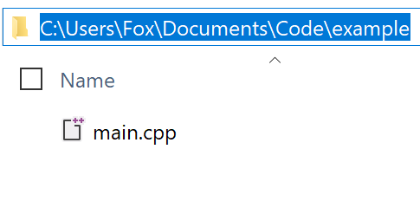
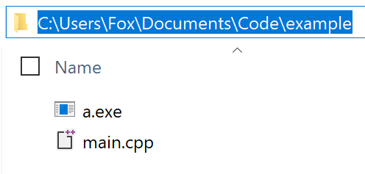
g++ - The C++ compiler from GCC (the GNU Compiler Collection)
g++, or g++.exe is the name of the compiler program
It accepts arguments in the form of code files as well as compiler options
We’ll talk more about command-line arguments later
> g++ main.cpp
Given a single file program (main.cpp), the simplest command to create a program from it would be:
> g++ main.cpp
(Build a program using main.cpp as the only file, and use the default name of the final executable)

Slide 14
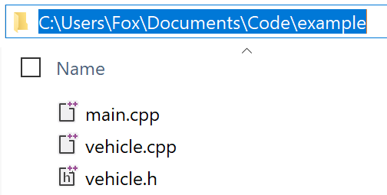
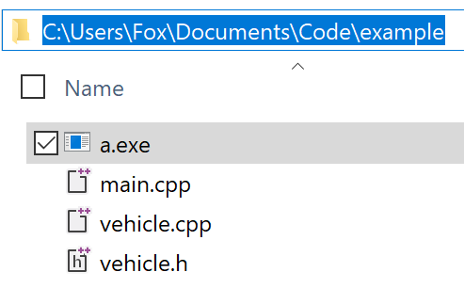
Building with multiple files
In a directory with files: main.cpp, vehicle.cpp and vehicle.h
> g++ main.cpp vehicle.cpp
We only specify source files (.h files are #included by those source files)
> g++ main.cpp vehicle.cpp
OR...
> g++ *.cpp
Compile ALL .cpp files in this directory (the * is called a wildcard)

Slide 15
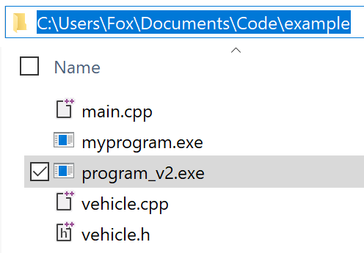
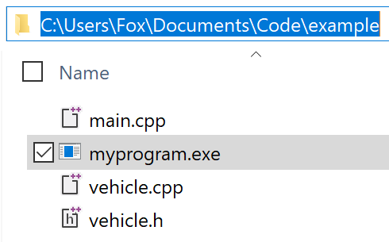
Renaming the output executable
The argument –o [filename] lets you specify the name of the executable that gets created
> g++ -o myprogram main.cpp vehicle.cpp
OR...
> g++ -o myprogram *.cpp
> g++ -o myprogram *.cpp
Build again, creating a second executable with a different name
> g++ -o program_v2 *.cpp

Slide 16
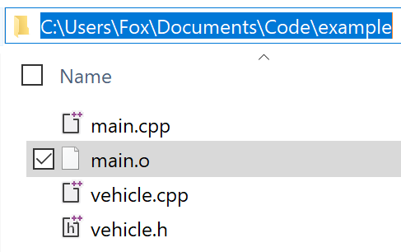
There are lots of arguments and options you can use
> g++ *.cpp
This will do a “full build” and generate an executable
What if you had dozens, hundreds of files? What if you wanted to just test if a single class (or function) just compiles?
The -c option will ONLY compile the specified files
> g++ -c main.cpp
The .o file is an object file, and get used by the linker to create the final executable

Slide 17
After compiling comes linking
Build the executable from a single object file (NOT a code file)
Doing separate compile / link operations is something you might not need to do often
> g++ -o helloworld main.o
Build an executable from MULTIPLE object files (assuming they exist)
In this course, we won’t have any programs (or project setups) that are so complex that we need to
> g++ -o myprogram main.o vehicle.o
In many cases, this is sufficient:
g++ -o [program_name] cpp_file(s)
OR... use wildcards again
> g++ -o myprogram *.o

Slide 18
What about other compilers?
Microsoft’s C++ compiler (called MSVC, or Microsoft Visual C++) uses an executable called cl.exe
Using it is similar (but NOT identical) to using g++
For GCC:
For MSVC:
> g++ [options – file(s), executable name, etc]
> cl [options – file(s), executable name, etc]

Slide 19
Quick and easy
In a directory with a source file called main.cpp
For GCC:
> g++ main.cpp // output is a.exe by default
For MSVC:
> cl main.cpp // output is main.exe
Default executable name is the first file compiled

Slide 20
Renaming an executable
In a directory with a source file called main.cpp
For GCC:
> g++ -o program main.cpp // program.exe
For MSVC:
> cl /Fe: program main.cpp // program.exe
/Fe:
Change the name of the executable
In the end, they’re both C++ compilers, and they can more or less do the same thing.
And so on, and so on…

Slide 21
What about complex builds?
cl /EHsc /Fe: RPG.exe *.cpp /link /LIBPATH:c:/pdcurses/wincon pdcurses.lib
cl - the base command
/EHsc - Turn on exception handling
/Fe - Name the executable
*.cpp - wildcard, use any file with .cpp extension
/link - Make use of a library, which contains
additional code
/LIBPATH - Where to find some or all libraries
pdcurses.lib - The actual library being linked
At first glance, that might all seem like a bunch of nonsense!
for (int i = 0; i < 10; i++)
cout << i * 5;
Not all like this:
Lots of things are strange at first, especially with programming!

Slide 22
There are a LOT of options
From MVSC – Microsoft’s C++ compiler
@
/?
/AI
/analyze
/arch
/await
/bigobj
/C
/c
/cgthreads
/clr
/constexpr
/D
/diagnostics
/doc
/E
/EH
/EP
/errorReport
/execution-charset
/F
/favor
/FA
/Fa
/FC
/Fd
/Fe
/FI
/Fi
/Fm
/Fo
/fp
/Fp
/FR
/Fr
/FS
/FU
/Fx
/GA
/Gd
/Ge
/GF
/GH
/Gh
/GL
/Gm
/GR
/Gr
/GS
/Gs
/GT
/guard:cf
/Gv
/Gw
/GX
/Gy
/GZ
/Gz
/H
/HELP
/homeparams
/hotpatch
/I
/J
/JMC
/kernel
/LD
/LDd
/link
/LN
/MD
/MDd
/MP
/MT
/MTd
/nologo
/O1
/O2
/Ob
/Od
/Og
/Oi
/openmp
/Os
/Ot
/Ox
/Oy
/P
/permissive-
/Qfast_transcendentals
/QIfist
/Qimprecise_fwaits
/Qpar
/Qsafe_fp_loads
/Qvec-report
/RTC
/sdl
/showIncludes
/source-charset
/std
/Tc
/TC
/Tp
/TP
/U
/u
/utf-8
/V
/validate-charset
/vd
/vmb
/vmg
/vmm
/vms
/vmv
/volatile
/w
/W0, /W1, /W2, /W3, /W4
/w1, /w2, /w3, /w4
/Wall
/wd
/we
/WL
/wo
/Wp64
/Wv
/WX
/X
/Y-
/Yc
/Yd
/Yl
/Yu
/Z7
/Za
/Zc
/Ze
/Zf
/Zg
/ZI
/Zi
/Zl
/Zm
/Zp
/Zs
/ZW
Fortunately, you don’t have to learn all of them!

Slide 23
There are a LOT of options
From MVSC – Microsoft’s C++ compiler
@
/?
/AI
/analyze
/arch
/await
/bigobj
/C
/c
/cgthreads
/clr
/constexpr
/D
/diagnostics
/doc
/E
/EH
/EP
/errorReport
/execution-charset
/F
/favor
/FA
/Fa
/FC
/Fd
/Fe
/FI
/Fi
/Fm
/Fo
/fp
/Fp
/FR
/Fr
/FS
/FU
/Fx
/GA
/Gd
/Ge
/GF
/GH
/Gh
/GL
/Gm
/GR
/Gr
/GS
/Gs
/GT
/guard:cf
/Gv
/Gw
/GX
/Gy
/GZ
/Gz
/H
/HELP
/homeparams
/hotpatch
/I
/J
/JMC
/kernel
/LD
/LDd
/link
/LN
/MD
/MDd
/MP
/MT
/MTd
/nologo
/O1
/O2
/Ob
/Od
/Og
/Oi
/openmp
/Os
/Ot
/Ox
/Oy
/P
/permissive-
/Qfast_transcendentals
/QIfist
/Qimprecise_fwaits
/Qpar
/Qsafe_fp_loads
/Qvec-report
/RTC
/sdl
/showIncludes
/source-charset
/std
/Tc
/TC
/Tp
/TP
/U
/u
/utf-8
/V
/validate-charset
/vd
/vmb
/vmg
/vmm
/vms
/vmv
/volatile
/w
/W0, /W1, /W2, /W3, /W4
/w1, /w2, /w3, /w4
/Wall
/wd
/we
/WL
/wo
/Wp64
/Wv
/WX
/X
/Y-
/Yc
/Yd
/Yl
/Yu
/Z7
/Za
/Zc
/Ze
/Zf
/Zg
/ZI
/Zi
/Zl
/Zm
/Zp
/Zs
/ZW
These all serve a purpose (or did, at one point—some may be older and deprecated)
Depending on what you do, you MAY need to learn SOME of them

Slide 24
What about larger projects? Complex projects?
Multiple files, multiple folders, external libraries, different build types (x86 vs x64, Debug vs Release), etc…
How do you build all of those?
Either get REALLY good at remembering typing lots of complex commands (was it /Fo or /Fe that I needed?), OR…
Makefiles

Slide 25
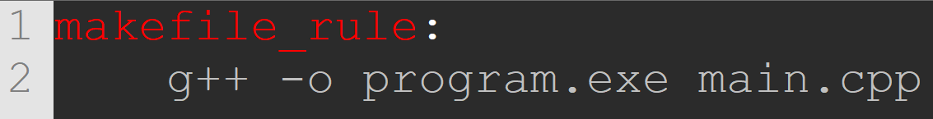
What’s a makefile?
A makefile is a files that contain a list of operations to perform (kind of a “to do” list)
Generally used to compile code and build programs
The makefile itself is just the instructions (the operating system and compiler will do the work)
A make program will read a makefile, and pass those instructions to the appropriate program
Super simple makefile – the command to build a program called program.exe from the file main.cpp

Slide 26
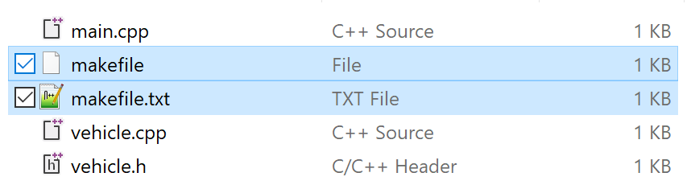
How do you create a makefile?
A makefile is just a plain text file, with these properties:
Its name is (usually) just: makefile
It has no extension—not makefile.txt, not makefile.make, just plain ol’ makefile
This is a makefile
You may have to turn on file extensions in your operating system’s file browser to remove any extension
THIS is an impostor, masquerading as a makefile!

Slide 27
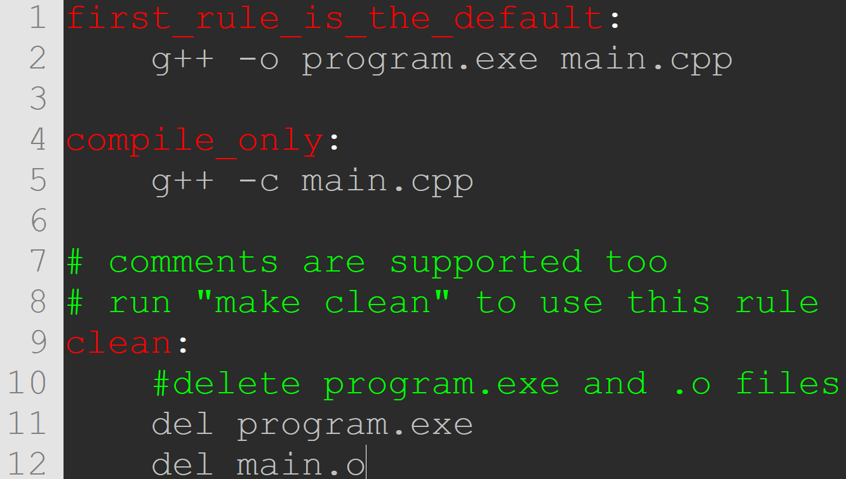
What’s inside a makefile?
It contains one or more rules that each contain a set of instructions
The first rule is executed by default, if nothing else is specified
Rules can be named anything you want
Code underneath a rule must be indented with a TAB (spaces will generate errors!)

Slide 28
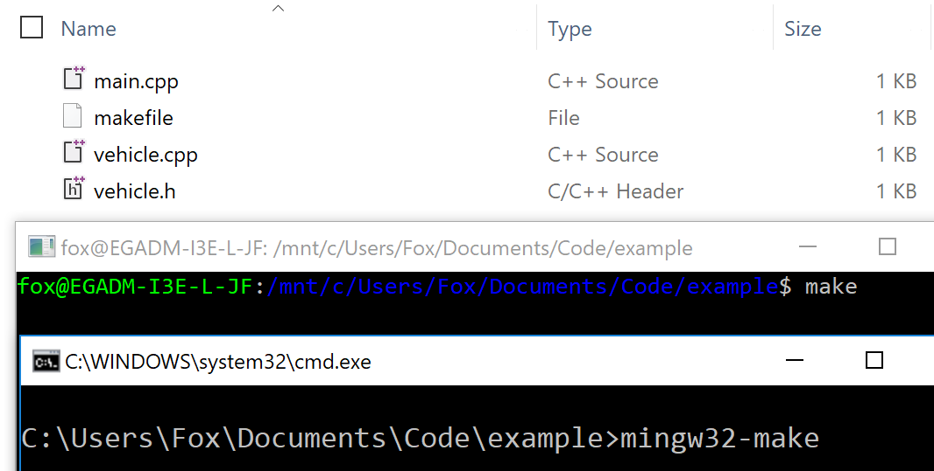
How do you “run” a makefile?
From a command-line interface, navigate to a folder containing a makefile
Run a “make” program
Both of these commands will do the same thing:
1. Search the current directory for a file named “makefile”
2. Open it, read it, execute the instructions
What’s up with the different names?

Slide 29
What’s a “make” program?
A program to open and read a makefile, and then execute the instructions contained within
There are many that do similar things (like compilers!)
It’s often called make (generally) but you may encounter:
make – The “standard” version, used by GCC
mingw32-make – make equivalent for GCC on Windows CMake – a different, but similar tool (used by CLion) nmake – a version for Microsoft’s compiler

Slide 30
Using a make program
makefile
IDE runs “make” or user does, from CLI
“make” program reads file, executes instructions
Output depends on instructions in the makefile
Build program Create folders Copy files etc…
The process for a user to execute all of the instructions is simple:
Just type the name of the make program
Simple makefile, with 1 or 2 lines of commands?
> make
Enormously complex makefile, with hundreds of commands?
> make
Makefiles allow for a layer of abstraction between the user and the actual commands
Similar to programming something in a class, and hiding it behind a function!

Slide 31
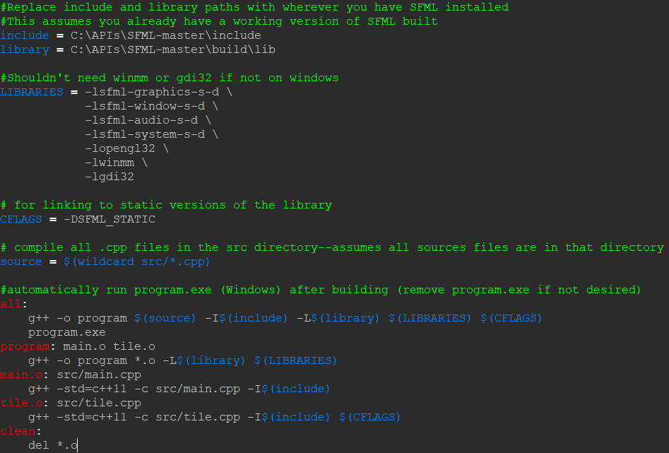
Makefiles can be quite complex
A makefile can have conditions, options based on OS, directory locations, command-line arguments, etc…
It’s a very versatile system – but a bit of a bear to get into
IDEs use some form of “make” under the hood

Slide 32
Command Line ARGUMENTS
Executing commands via command line can be aided by passing arguments to the executable
Just like arguments to a function
// Normal main
int main()
{
return 0;
}
// main() with command-line arguments
int main(int argc, const char **argv)
{
return 0;
}

Slide 33
Command-line arguments
argc – How many arguments are there
There will always be at least one—the name of the program itself
argv – An array of char * (strings), each of the arguments passed to the program
int main(int argc, const char **argv)
{
return 0;
}
char ** vs char *[], same thing. An array of character pointers, an array of character arrays—an array of strings.
// Alternately…
int main(int argc, const char *argv[])
{
return 0;
}

Slide 34
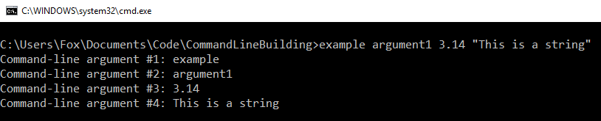

Example
The first argument (argv[0]) should always be the name of the program

Slide 35
Using arguments in your program
int main(int argc, char **argv)
{
if (argc > 1) // if there is more than just the executable name
{
// Print out all the arguments
for (int i = 1; i < argc; i++)
cout << "Argument: " << argv[i] << endl;
}
if (argc == 2)
DoSomethingWithArgument(argv[1]); // Use the "first" argument
else
{
cout << "Invalid arg count! Usage is: program <argument1>" << endl;
return -1;
}
return 0;
}
We can start at 1, we probably don’t need the name of the executable
You may check for specific numbers of arguments, depending on your program
A program might require arguments—no arguments, no working program

Slide 36
Why work in the command line?
Some things can be faster using it (especially with practice)
For writing smaller bits of code, a text editor and command-line compiling can be faster than an IDE
Some aspects of development require it (make files)
You may develop a personal preference for it
…or you may hate it
Regardless, you should be familiar with it
If you do have to use it, it shouldn’t be scary
Understanding something, being proficient at something…
Is NOT the same as liking that thing

Slide 37
Recap
Building code with a command-line interface is just another option
In some cases it might be faster than using an IDE
Some processes may require it, or you may prefer it
An IDE is really just shell around a compiler—command-line compiling bypasses the “middle man” that is the IDE
You may have to learn a lot of options that are typically “done for you” in your IDE—but this can lead to a lot of power and flexibility
Command-line arguments can be passed to a program as a way of customizing how a program gets used
They require making a change to the signature of main()

